Slide 1
Cybersecurity Experience: Stakeholder Presentation
By: Kaustuv Dutta, Sime Weldegrebrile, Venkat Sabbineni, Sai Lu, Jeremiah Warren

Slide 2
Background/Introduction
Client current compliance (CMMC Level 2)
Based on NIST SP 800 – 171
Objective
To assess progress towards CMMC Level 3 compliance
Assessment questionnaire: 39 questions
Based on enhancements from NIST SP 800 – 172

Slide 3
Overview
The Capstone Group conducted a cybersecurity assessment of the client to evaluate their compliance with the Department of Defense's Cybersecurity Maturity Model Certification (CMMC) program.
The client was found to be compliant with Level 2 of the CMMC Version 2.0 and is undergoing the process of becoming compliant with Level 3.
The Capstone Group created a questionnaire to serve as a status report for the client's ongoing Level 3 compliance efforts and produced actionable recommendations that might be used by the client to ensure executive alignment with the CMMC compliance process.
The findings showed that 33% of the total controls were fully implemented, 31% of the controls had not been begun, 26% of the controls were partially implemented, and 10% of the controls were previously implemented under NIST SP 800-171. The recommendations provide guidelines for an organization to comply with the enhanced security.

Slide 4
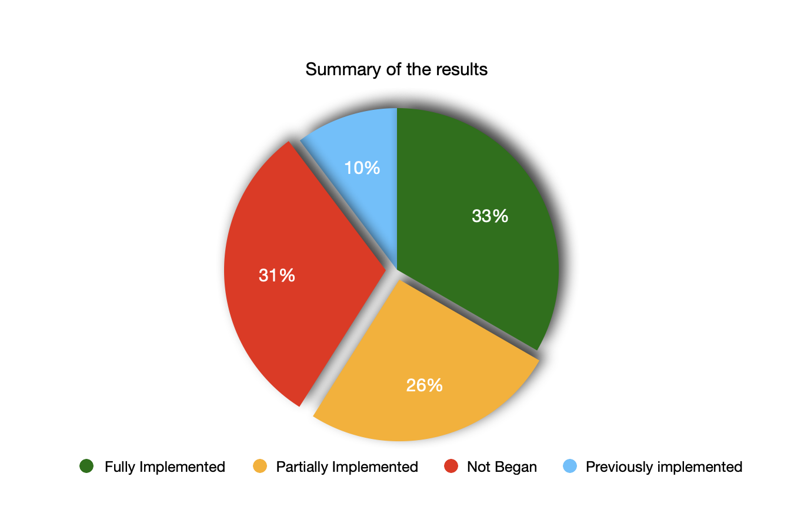
Summary of Results
39 controls
13 fully implemented
10 partially implemented
12 not begun
4 previously implemented during NIST SP 800-171 DoD Assessment

Slide 5
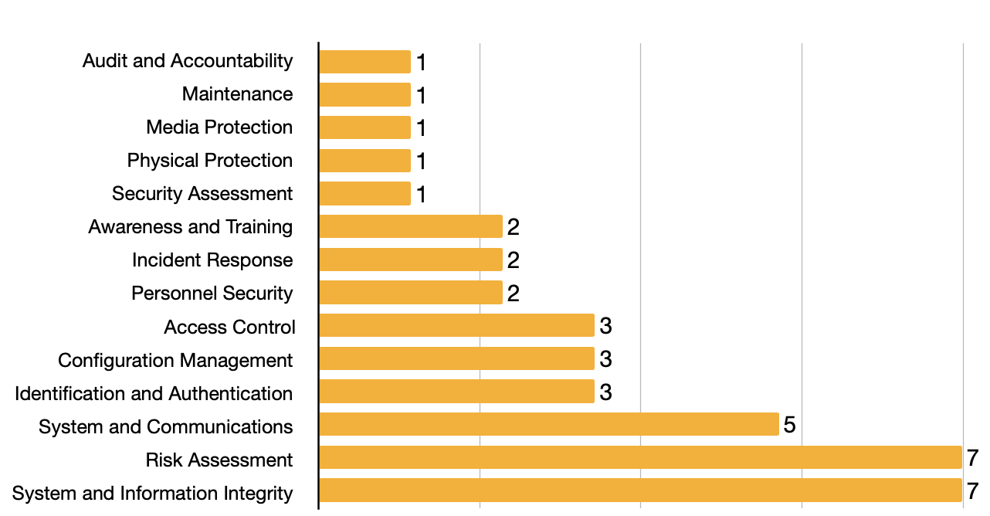
Number of Controls for each Family of controls

Slide 6
Results by Control Family
Access Control: 3 Controls
1 Fully Implemented
1 Partially Implemented
1 Not Begun
Awareness and Training: 2 Controls
2 Fully Implemented
Audit and Accountability: 1 Control
1 previously implemented during NIST SP 800-171 DoD Assessment
Configuration Management: 3 Controls
2 Fully Implemented
1 Not Begun
Identification and Authentication: 3 Controls
1 Fully Implemented
2 Partially Implemented
Incident Response: 2 Controls
2 Not Begun
Maintenance: 1 Control
1 previously implemented during NIST SP 800-171 DoD Assessment
Media Protection: 1 Control
1 previously implemented during NIST SP 800-171 DoD Assessment
Personnel Security: 2 Controls
2 Fully Implemented
Physical Protection: 1 Control
1 previously implemented during NIST SP 800-171 DoD Assessment
Risk Assessment: 7 Total Controls
4 Not Begun
2 Partially Implemented
1 Fully Implemented
Security Assessment: 1 Total Control
1 Not Begun
System and Communications: 5 Total Controls
2 Fully Implemented
2 Partially Implemented
1 Not Begun
System and Information Integrity: 7 Total Controls
3 Partially Implemented
2 Not Begun
2 Fully Implemented
Notes:
- Don’t spend long on this slide, move to the graph, which is a better visual representation

Slide 7
Controls previously implemented during NIST SP 800-171 DoD Assessment
Audit and Accountability: 1 control previously implemented during NIST SP 800-171 DoD Assessment
Maintenance: 1 control previously implemented during NIST SP 800-171 DoD Assessment
Media Protection: 1 control previously implemented during NIST SP 800-171 DoD Assessment
Physical Protection: 1 control previously implemented during NIST SP 800-171 DoD Assessment

Slide 8
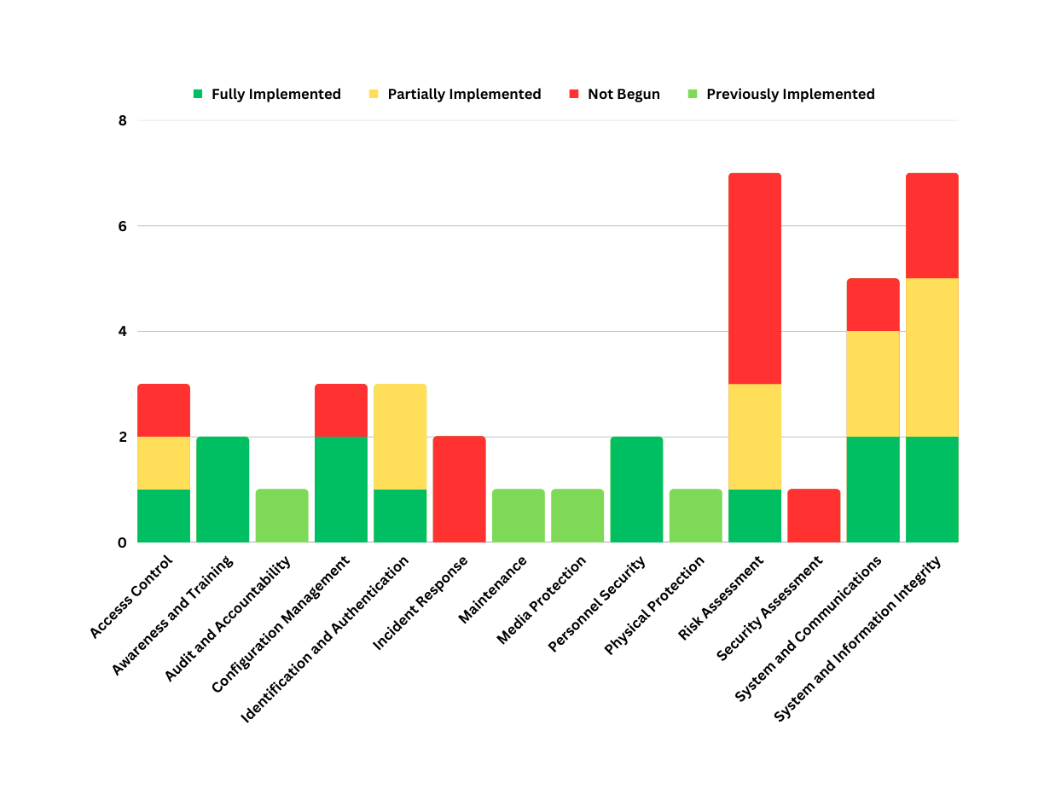

Slide 9
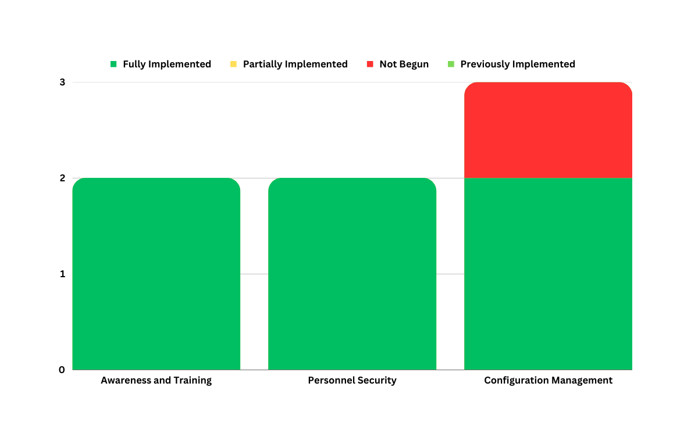
Control Families with the Highest Percentage of Controls Fully Implemented
Awareness and Training - 100% of controls fully implemented
Personnel Security - 100% of controls fully implemented
Configuration Management - 66% of controls fully implemented
Note: Excludes results with controls previously implemented during NIST SP 800-171 DoD Assessment

Slide 10
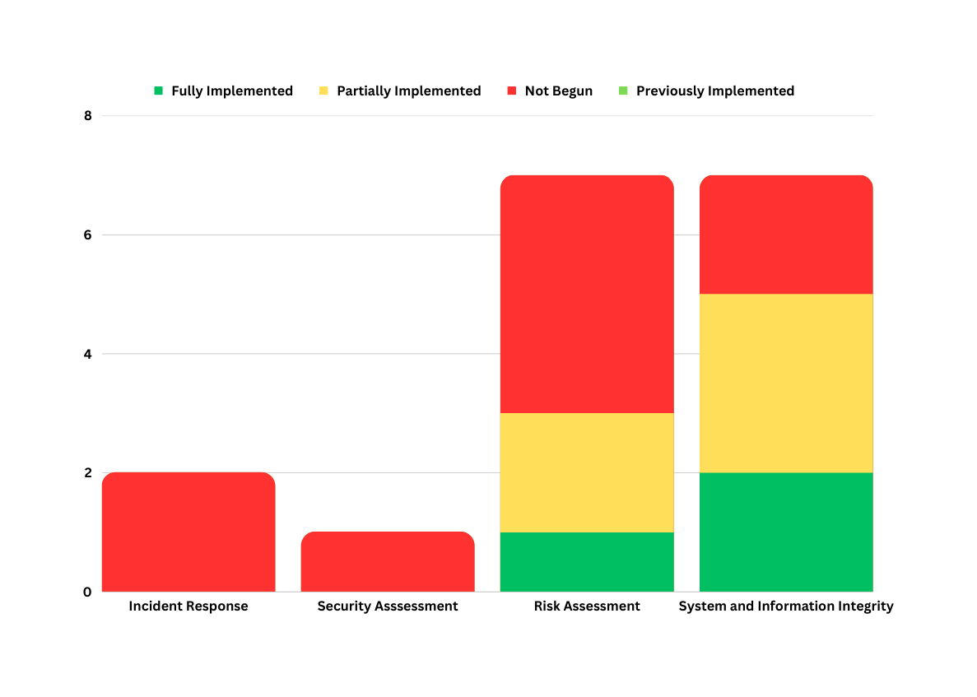
Control Family with the Lowest Percentage of Controls Fully Implemented (includes partially implemented controls and controls not that have not begun to be implemented
Incident Response - 0% fully implemented - 2 controls not begun
Security Assessment - 0% fully implemented - 1 control not begun
Risk Assessment - 14% fully implemented - 4 controls not begun, and 2 controls partially implemented
System and Information Integrity: - 28% fully implemented - 2 controls not begun, and 3 controls partially implemented

Slide 11
Recommendations/Things To Keep In Mind
As part of our review, we developed recommendations/things to keep in mind while working towards fully implementing all the enhancements found in NIST SP 800-172
For this presentation, we included recommendations for the control families with the lowest percentage of controls fully implemented, specifically focusing on the controls that have not begun to be implemented in these control families
Please refer to the findings document for recommendations for each controls that has not been fully implemented

Slide 12
Recommendations: Incident Response
Establish and maintain
Establish and maintain a cyber incident response team
Develop
Develop a documented plan for incident response that includes the roles and responsibilities of the cyber incident response team
Ensure
Ensure that the team has access to the necessary resources, including technology, tools, and information, to respond to cyber incidents
Consider
If the organization lacks the internal resources to build an internal CSIRT team, consider an outsourced CSIRT

Slide 13
Recommendations: Security Assessment
Develop
Develop a plan for conducting regular penetration testing at an organization-defined frequency
Ensure
Ensure that the individuals conducting the tests are qualified and knowledgeable in the latest penetration testing techniques
Keep
Keep records of the results of the penetration testing
Remediate
Remediate any vulnerabilities discovered during penetration testing

Slide 14
Recommendations: Risk Assessment
Threat Intelligence: Identify and select threat intelligence source
Can outsource this control if organization lacks internal capabilities
Supply chain: Vet suppliers and monitor their security practices
Supply chain: Conduct a risk assessment of the organization’s supply chain
Use this risk assessment to develop a plan for managing supply chain risk

Slide 15
Recommendations: System and Information Integrity
Persistent organizational storage locations: Start by cataloguing all information available at these locations
Determine which information is no longer needed and then remove
Develop a plan to remove information that is no longer needed on a consistent basis
Threat indicator information: Identify and establish relationships with relevant external organizations
Establish dedicated team or personnel responsible for intrusion detection and threat hunting activities

Slide 16

Any Questions?

